Slide 1

Elements Business Development Task
By : Mohamed Elgindy

Slide 2
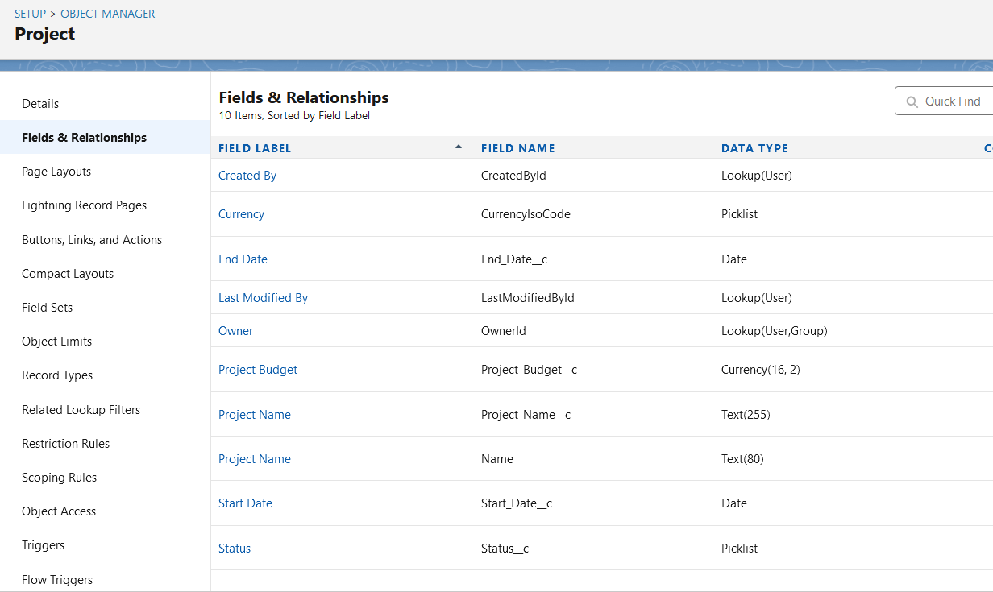
Project Opjects and component

Slide 3
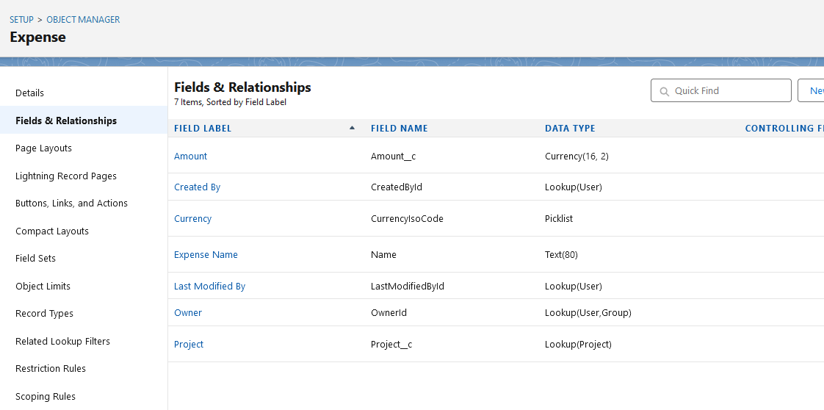
Expense Object and lookup

Slide 4
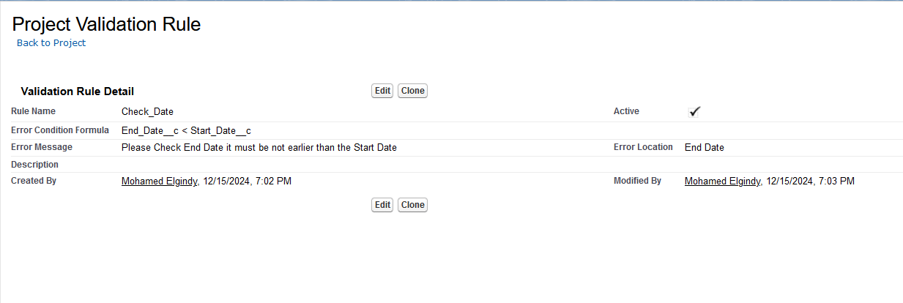
validation rule

Slide 5
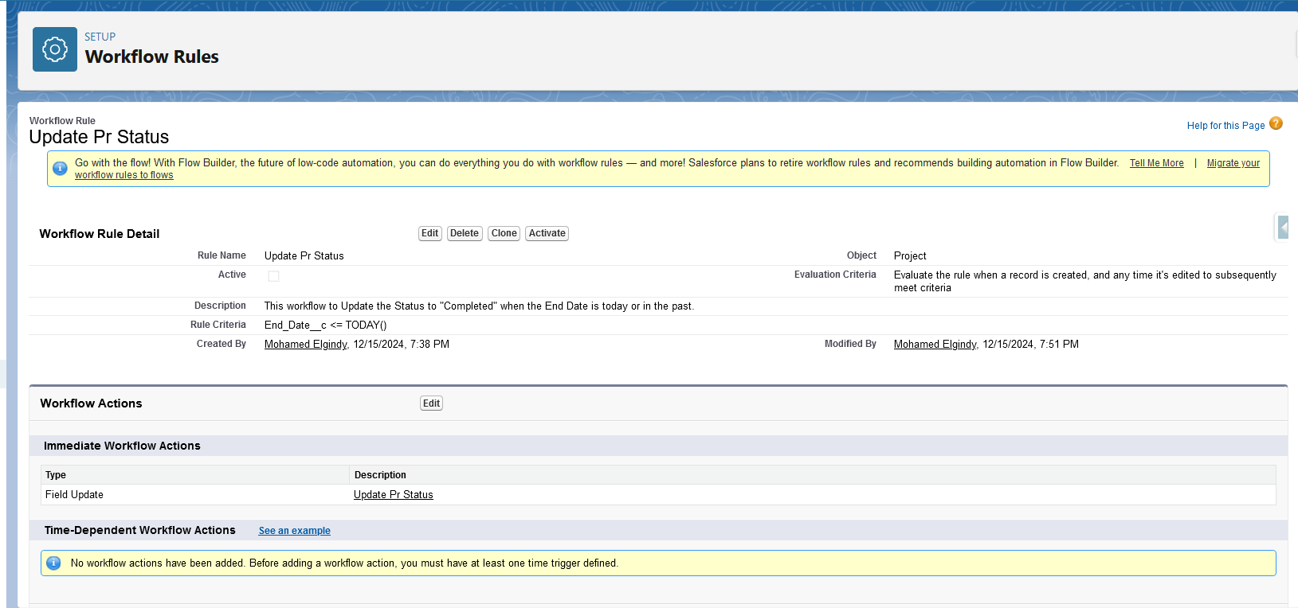
Workflow To Update Status

Slide 6
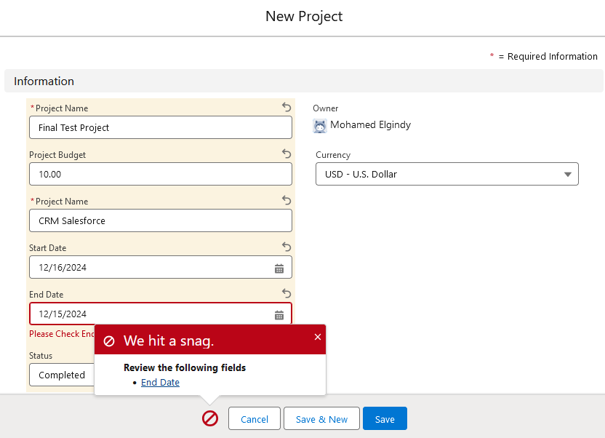
Date Validation

Slide 7
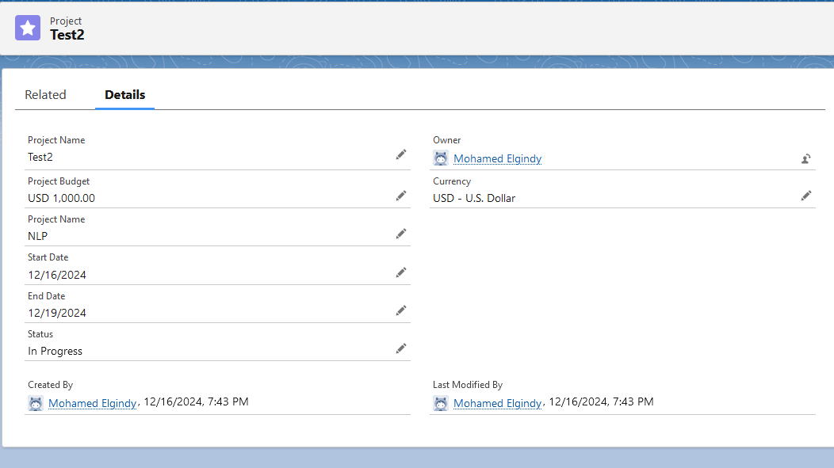
Test Demo

Slide 8
Apex Programming Task

Slide 9
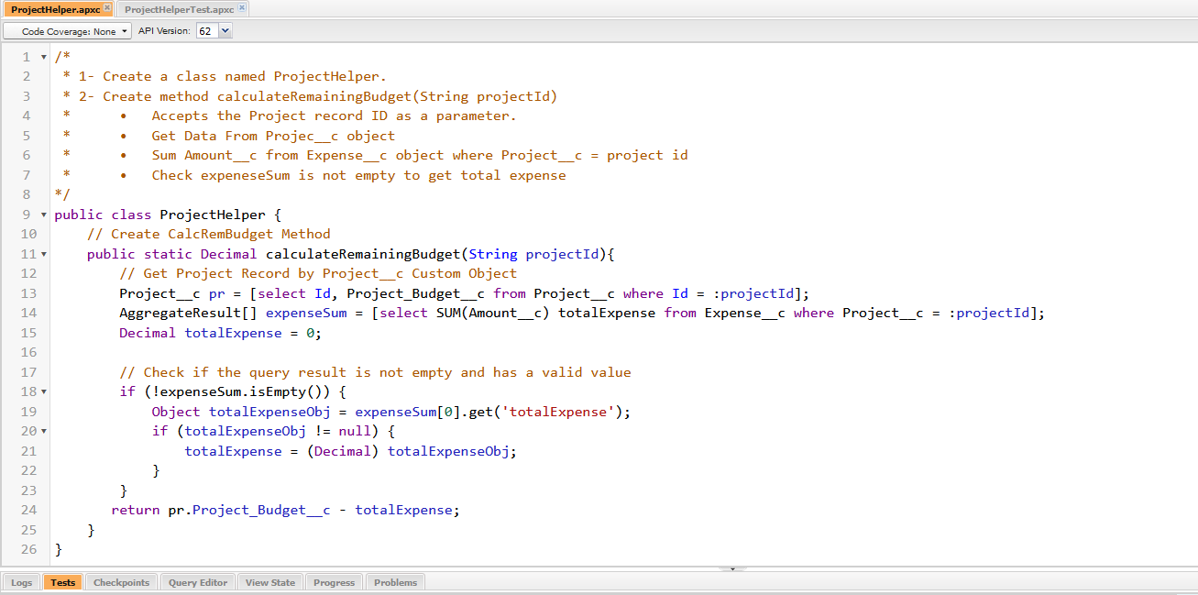
ProjectHelper Class

Slide 10
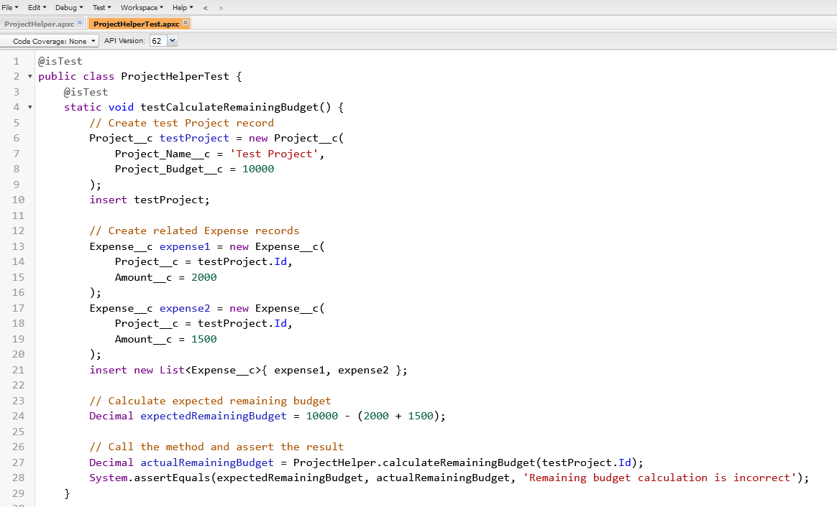
ProjectHelperTest class

Slide 11
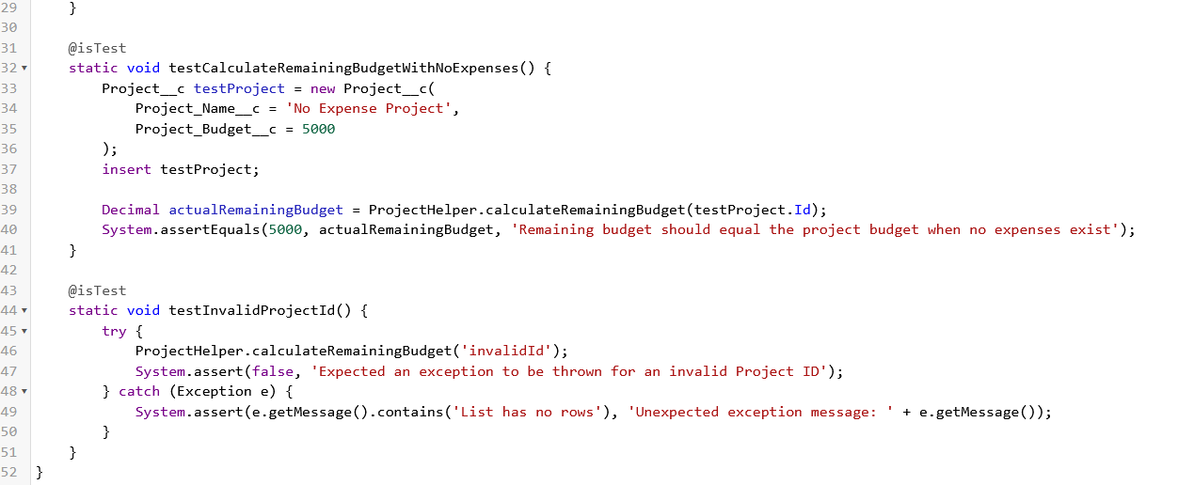
ProjectHelperTest class

Slide 12
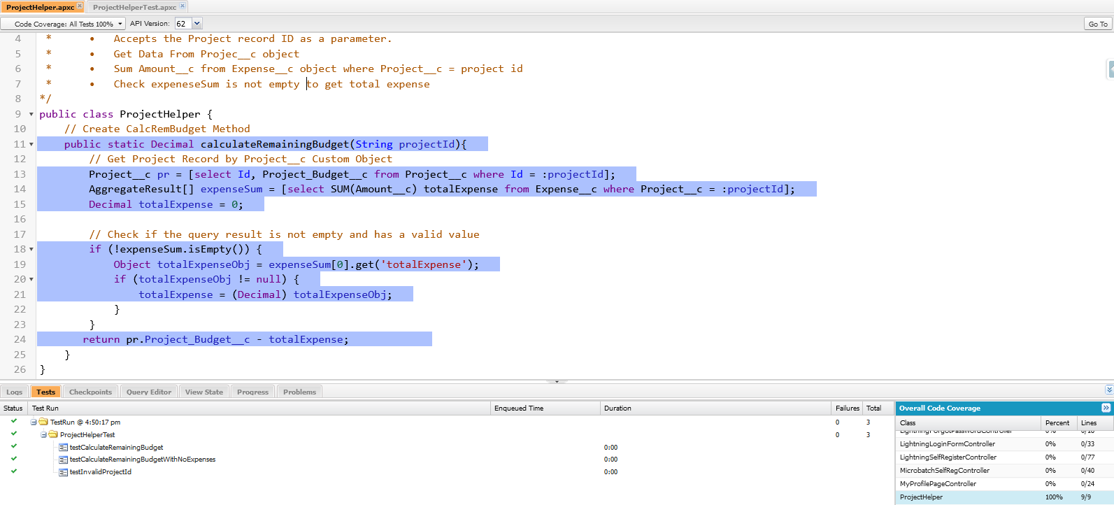
Test code coverage

Slide 13
Lightning Web Component (LWC) Task

Slide 14
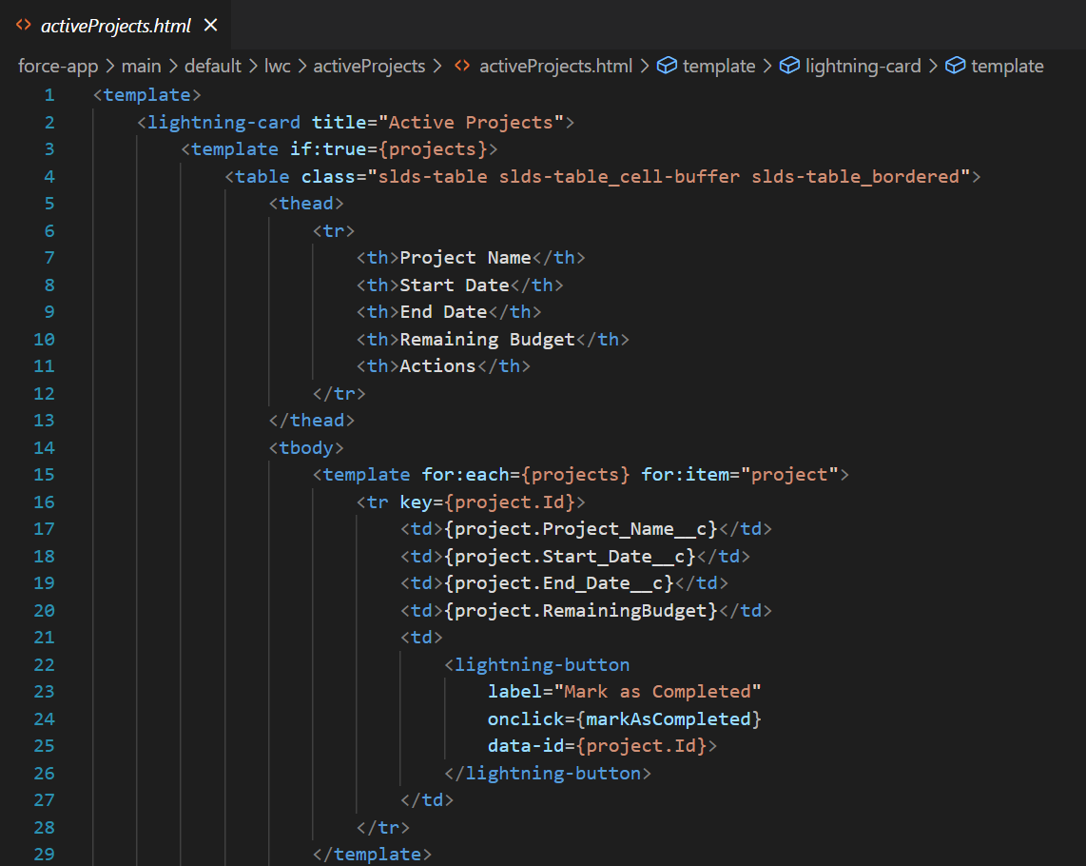
HTML code

Slide 15
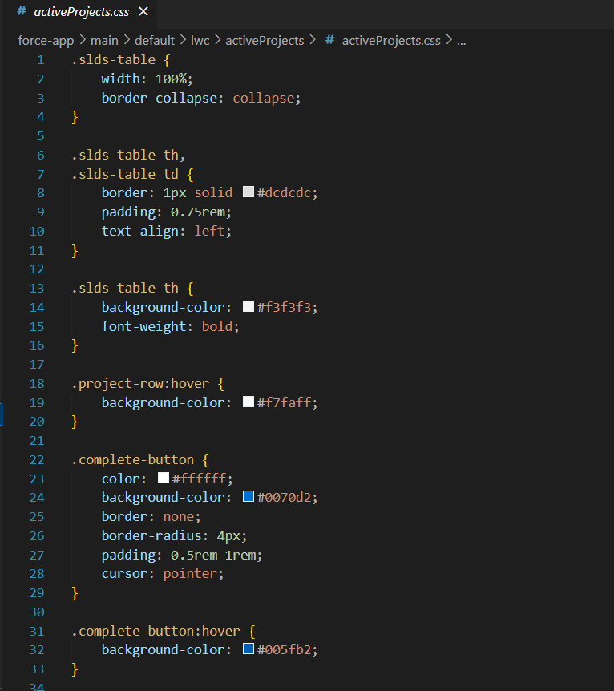
Css Code

Slide 16
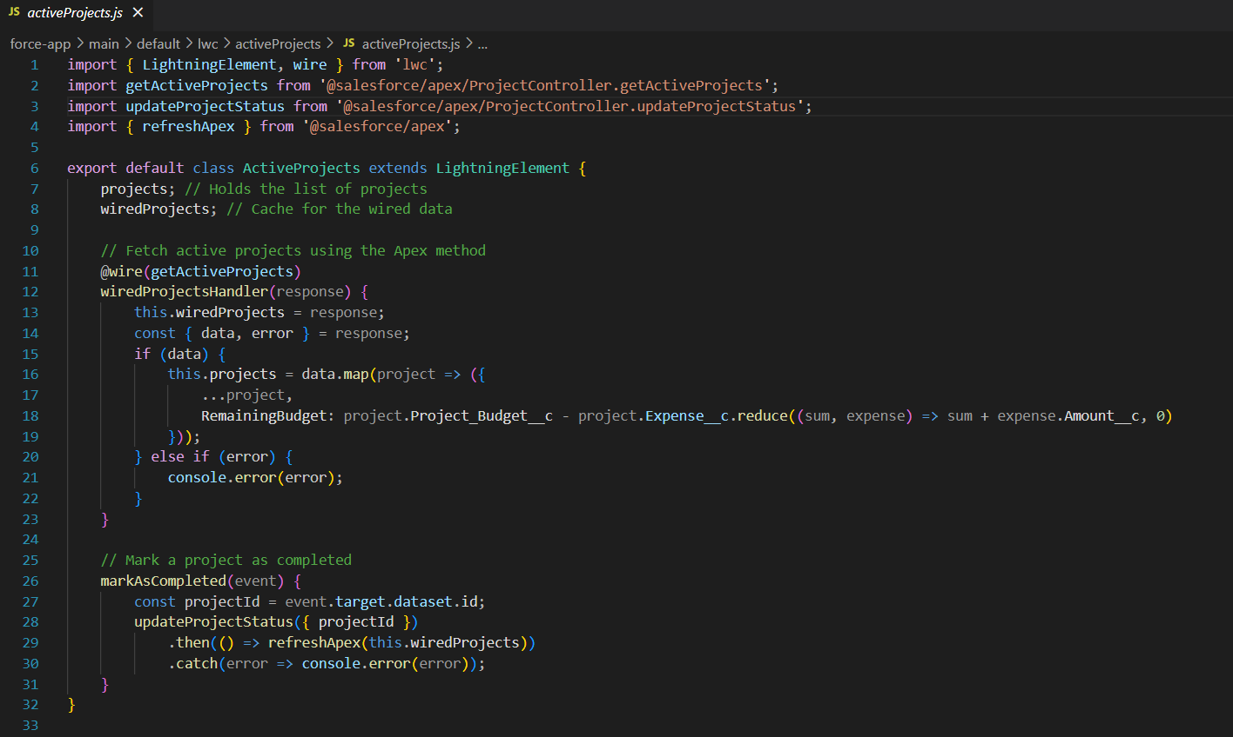
Javascript code

Slide 17
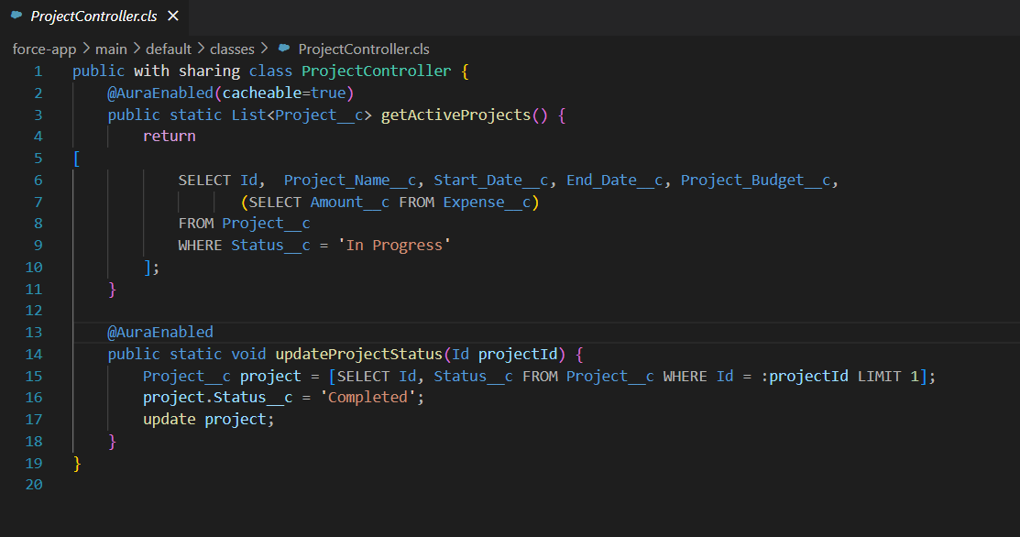
Apex Controller code

Slide 18
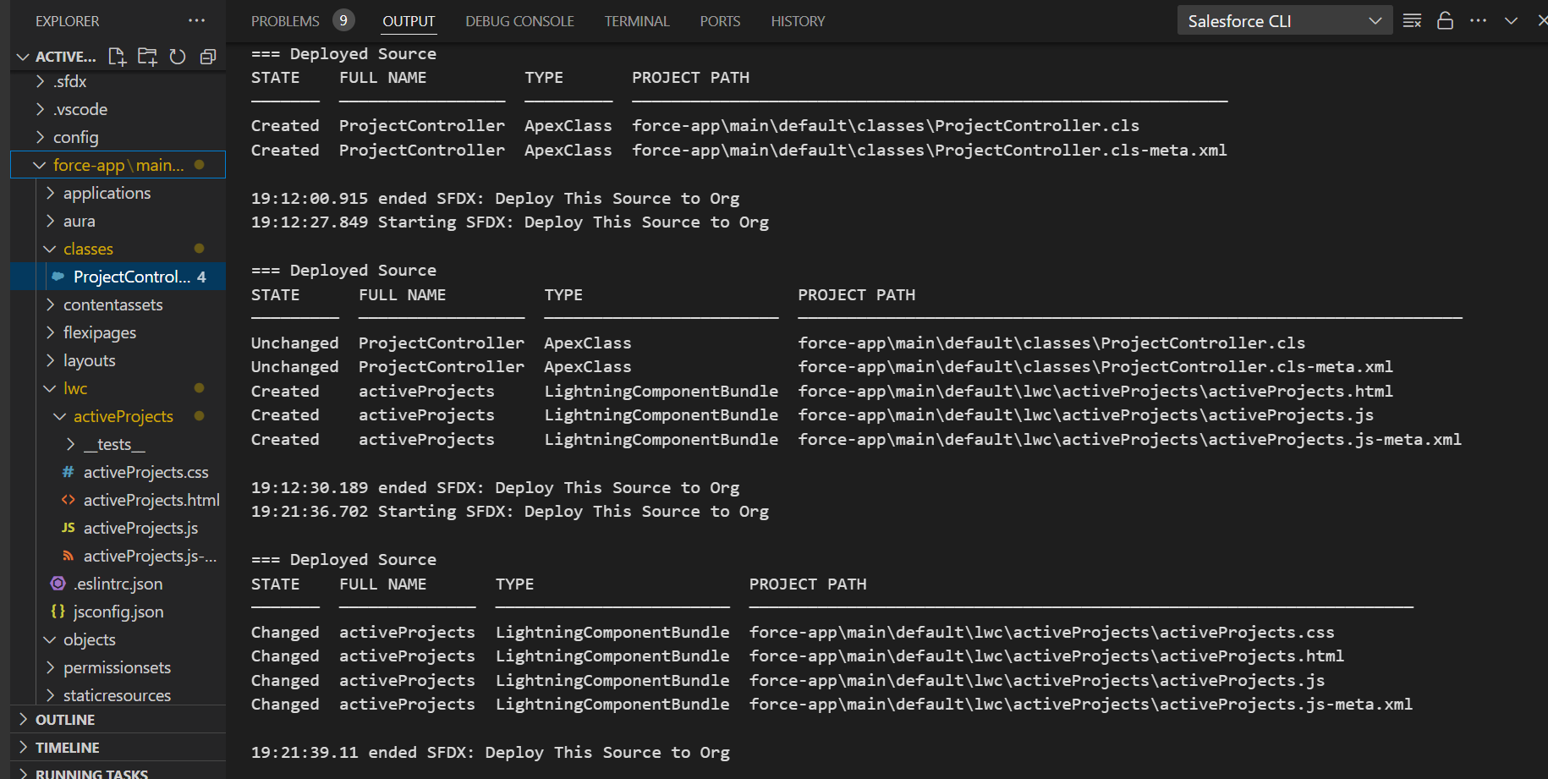
Deployment

Slide 19
Thank You

